Slide 1



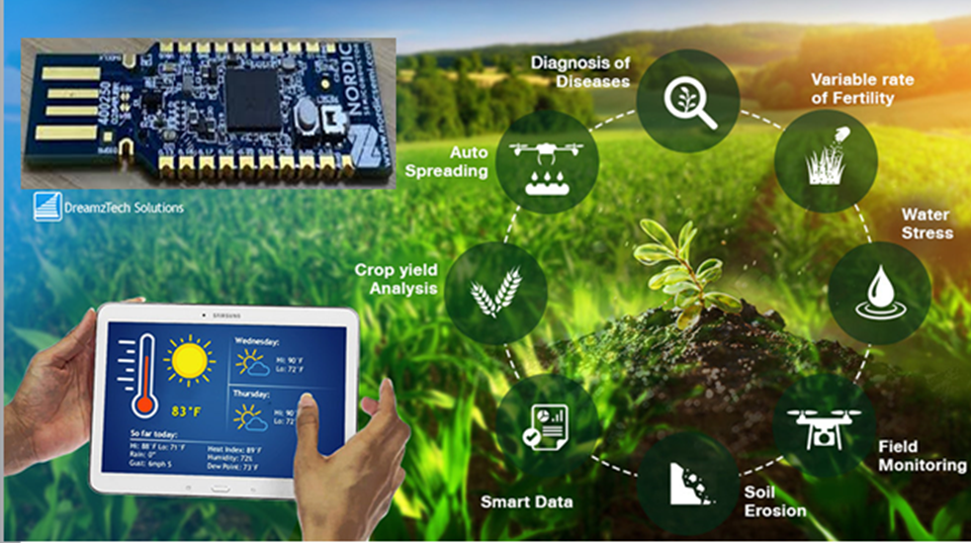
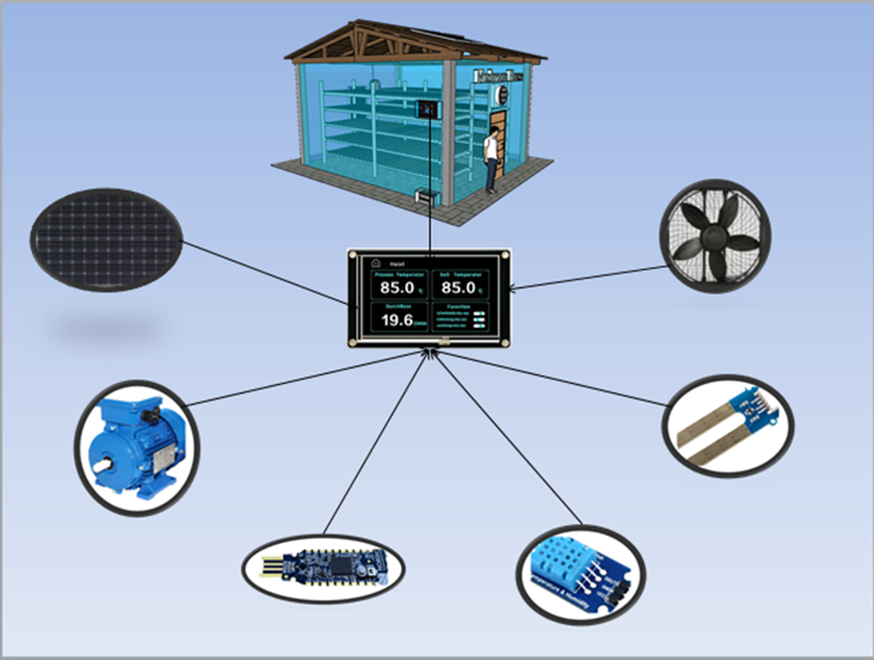
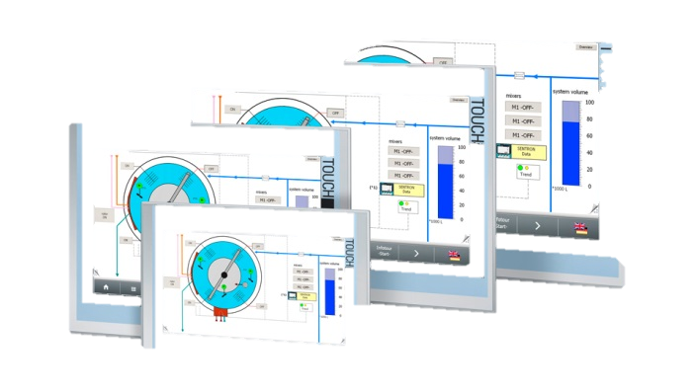
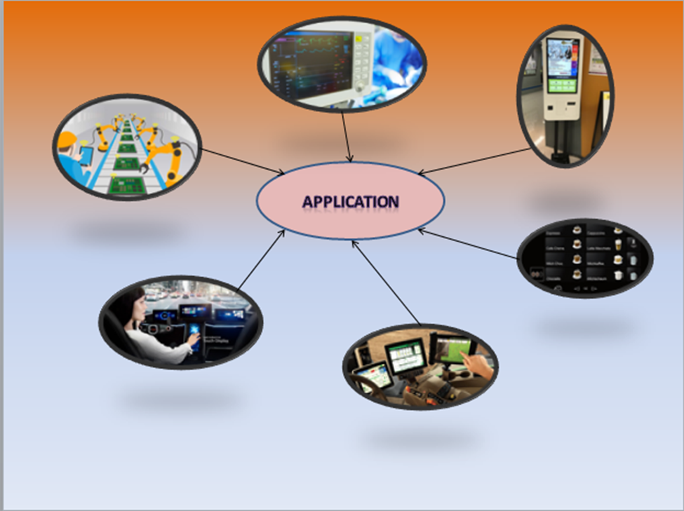
Smart HMI Controller for Agricultural Application
INTRODUCTION
OBJECTIVES
Human Machine Interface (HMI) is useful for user/farmer to control and monitor the smart farming system. It is the interface between user and control/monitoring system in the greenhouse or farm. The farmers can check and regulated the amount of water, temperature, soil moisture and other parameters via this HMI
In this project, the interface of HMI is designed to run on a nx8048k050 touch screen and connected with smart farm control system. It allows users to input the desired value of parameters such as temperature and humidity to the system. It can also display the parameter on the screen as well.
ARCHITECTURE
The HMI is designed software with a nextion editor that provides software for viewing temperature, humidity, fan, water, and motors in the order of each device screen. In the HMI there are 8 screens, each screen has a design button and the value of max, min Click to see the data of the device in the greenhouse. In greenhouse, HMI is connected with devices such as temperature, humidity, Fan, water , Heater, Solar, Soil moisture,
Smart Mushroom
Fig.1 view data
PROCESSING
Arduino is used to integrating software into nrf52840 and HMI. nrf52840 Used to receive data and input that data to the device. The device also provides feedback for checking the temperature, soil moisture, and weather in the crop to the HMI. HMI is a system that can control and stop all systems. To get all the data into the HMI, connect the HMI with nrf52840, a sensor that pulls the data contained in the smart mushroom sponsor into the HMI screen.
Solar
HMI
Fan
Humidity
Motor
Temperature
nrf52840
Fig.2 Smart mushroom
Application
HMI is widely using :
In Car
Controller in factory
Hospital
Company
Coffee shop
Framer
Fig.4 Smart HMI
CONTACT
ADVISOR : HEL Chanthan
TEP Sovichea
STUDENT : BIN Chanthy
EMAIL : chanthybin3@gmail.com
Fig.3 HMI User

